Slide 1
Mathematics (9-1) - iGCSE
2018-20
Year 09
Economists and scientists use graphs to help visualise the relationship between different variables. The diagram shows a common supply and demand graph used in economics. The demand graph shows that as the price of goods falls, the more we want to buy.
The supply graph shows that as the price of goods falls, the less we want to sell.
What is represented by the coordinates where the graphs intersect?
Unit 19 – Proportion & Graphs

Slide 2
Contents
Page iv
19 Proportion and graphs 587
Prior knowledge check 587
19.1 Direct proportion 588
19.2 More direct proportion 590
19.3 Inverse proportion 592
19.4 Exponential functions 595
19.5 Non-linear graphs 598
19.6 Translating graphs of functions 602
19.7 Reflecting and stretching graphs of functions 605
Problem-solving: Modelling outbreaks 610
Checkup 611
Strengthen 613
Extend 615
Knowledge check 619
Unit test 621

Slide 3
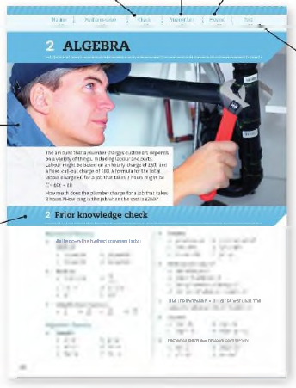
Contents
Page v
At the end of the Master lessons, take a check-up test to help you to decide whether to strengthen or Extend our learning
Extend helps you to apply the maths you know to some different situations
Unit Openers put the maths you are about to learn into a real-life context. Have a go at the question - it uses maths you have already learnt so you should be able to answer it at the start of the unit.
When you have finished the whole unit, a Unit test helps you see how much progress you are making.
Choose only the topics in strengthen thay you need a bit more practice with. You’ll find more hints here to lead you through specific questions. Then move on to Extend
Use the Prior knowledge check to make sure you are ready to start the main lessons in the unit. It checks your knowledge from Key Stage 3 and from earlier in the GCSE course. Your teacher has access to worksheets if you need to recap anything.

Slide 4
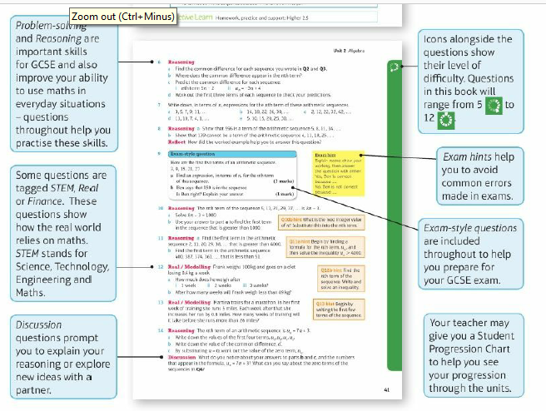
Contents
Page vi

Slide 5
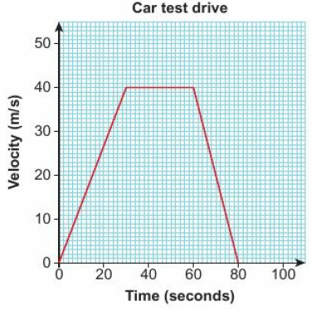
19 – Prior Knowledge Check
Page 587
Graphical fluency
The velocity- time graph shows a car's test drive. The car traveller in a straight line. Work out
its acceleration in m/s² for the first 30 seconds
its deceleration in m/s² at the end of the drive
the distance travelled.

Slide 6
19 – Prior Knowledge Check
Page 587
Which graph shows direct proportion?
Sketch the graphs of
y = x² b. y = x³ c. y = -x² d. y = x² - 4x + 7

Slide 7
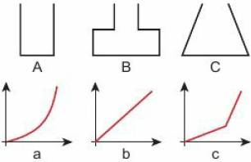
19 – Prior Knowledge Check
Page 587
Water is poured into each container at a steady rate. The graphs show how the depth of water changes. Match each graph to a container.

Slide 8
19 – Prior Knowledge Check
Page 587
Water is poured into each container at a steady rate. The graphs show how the depth of water changes. Match each graph to a container.

Slide 9
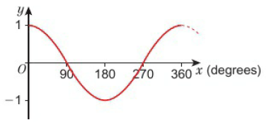
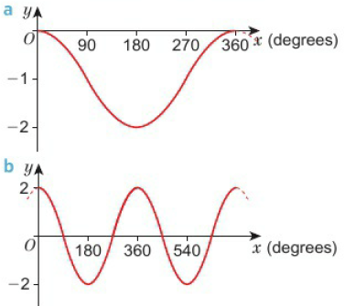
19 – Prior Knowledge Check
Page 588
Here is the graph of y = cosx Write the equation of each graph.

Slide 10
19 – Prior Knowledge Check
Page 588
Numerical Fluency
A boat sails a distance of 6 km at a constant speed of 15km/hour. How many minutes does the journey take?
Write the reciprocal of
3 b. 0.5 c. X
Work out
2⁻² b. 2⁻¹ c. 2°
3² e. 3⁻¹

Slide 11
19 – Prior Knowledge Check
Page 588
The tables show information about two pairs of variables.
Which pair of variables are directly proportional?
Find the formula linking the pair of proportional variables.
Algebraic fluency
f(x)= 2x² - 8
Work out f(3).
Find the values of a where f(a) = 0.
Write out in full f(x + 3)
a | 2 | 6 | 8 | 20 | 100
b | 10 | 30 | 35 | 95 | 450
c | 3 | 7 | 9 | 14 | 21
d | 21 | 49 | 63 | 98 | 147

Slide 12
19 – Prior Knowledge Check
Page 588
* Challenge
Any number multiplied by its reciprocal is always equal to 1. For example, ½ x 2 = 1
Pair these numbers up so their product is 1.
Write four more product pairs that equal 1.
4 8 5 0.25
0.2 0.125 10 0.1
2.5 0.4 1.6 0.625
Q11 hint - Convert the decimals into fractions

Slide 13
19.1 – Direct Proportion
Page 588
Objectives |  |  | Why Learn This?
Write and use equations to solve problems involving direct proportion. |  |  | Direct proportion is used to calculate exchange rates and compare prices of goods from different countries.
Fluency
Are x and y in direct proportion? How can you tell?
x | 3 | 5 | 8
y | 12 | 20 | 40
ActiveLearn - Homework, practice and support: Higher 19.1

Slide 14
19.1 – Direct Proportion
Page 589
Is cost in direct proportion to the quantity? If so, write an equation linking cost and quantity,
5 apples cost £4.20 and 15 apples cost £12.60.
500 Mb of data costs £47 and 50 Mb of data costs £6.
750 screws cost £12 and 1000 screws cost £14.
120 units of gas costs £40 and 80 units of gas costs £30.
Warm Up
Q1 hint - Compare ratios cost : quantity
Questions in this unit are targeted at the steps indicated.

Slide 15
19.1 – Direct Proportion
Page 589
Finance / Reasoning The tables show the price paid for different quantities of euros from two currency exchange websites in July.
Draw a scatter graph for both sets of information on the same axes,
b Draw a line of best fit for each set of data.
Write a formula for euros, E, in terms of sterling, S, for:
travelcash.com ii. currencyexchange.co.uk
d Which currency exchange website offers the best value for money? Explain your answer.
Discussion How can you tell that two quantities are in direct proportion from their graph? How can you tell that two quantities are in direct proportion from an equation?
Travelcash.com currency exchange.c.uk
Sterling (£) | 501 | 210 | 120 | 400 | 380 | 300 | 250 | 280
Euros (€) | 60 | 260 | 150 | 520 | 470 | 390 | 300 | 350
Sterling (£) | 400 | 150 | 30 | 250 | 350 | 300 | 200 | 450
Euros (€) | 440 | 260 | 32 | 280 | 390 | 330 | 210 | 500
Q2 hint - E= □S

Slide 16
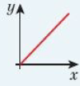
19.1 – Direct Proportion
Page 589
Key Point 1
The symbol ∝ means 'is directly proportional to'. y ∝ x means y is directly proportional to x. In general if y is directly proportional to x, y ∝ x and y = kx where k is a number, called the constant of proportionality.
Example 1
y is directly proportional to x. When y = 20, x = 8
Express y in terms of x.
Find x when y = 35.
a y ∝ x
So, y = kx
k = 2.5
y = 2.5x
b 35 - 2.5 x x
x = 14
Write y is directly proportional to x, using the symbol ∝
Write the equation using k.
Substitute y = 20 and x = 8. Solve to find k.
Substitute the value of k back into the equation.
Substitute y = 35 into y = 2.5x.

Slide 17
19.1 – Direct Proportion
Page 590
y is directly proportional to x. y = 15 when x = 3
Express y in terms of x.
Find y when x = 10
Find x when y = 65
y is directly proportional to x. y = 52 when x = 8
Write a formula for y in terms of x.
Find y when x = 14.
Find x when y = 143?
Q3a hint - Start with the statement y ∝ x, then the equation y = kx. Use the values of x and y to find the value of k.

Slide 18
19.1 – Direct Proportion
Page 590
Problem-solving y is directly proportional to x.
y = 6 when x = 4. Find x when y = 7.5
y = 31.5 when x = 7. Find x when y = 45.5
y = 8 when x = 5. Find x when y =13
6 – Exam-Style Questions
y is directly proportional to x.
When x = 600, y = 10
Find a formula for y in terms of x. (3 marks)
Calculate the value of y when x = 540. (1 mark)
June 2012 QI3, 5MB3H/01 1
Exam hint - Most of the marks are for part a. Show all of the working you do to get your formula.

Slide 19
19.2 – More Direct Proportion
Page 588
Objectives |  |  | Why Learn This?
Write and use equations to solve problems involving direct proportion. Solve problems involving square and cubic proportionality. |  |  | Scientists use statements of proportionality to write equations for different variables.
Fluency
y ∝ x. What are the values of A and B?
x | 3 | 4 | B
y | A | 18 | 63
ActiveLearn - Homework, practice and support: Higher 19.2

Slide 20
19.2 – More Direct Proportion
Page 590
Warm Up
y ∝ x Use the table of values to find the constant of proportionality.
Reasoning The force, F, on a mass is directly proportional to the acceleration, a, of the mass. When F= 96, a = 12
Express F in terms of a.
Find F when a = 20.
Find a when F = 112.
x | 6 | 10 | 12
y | 15 | 25 | 30
Q2a hint - Start with the statement F ∝ a, then equation F = ka.
Use the values of F and a to find the value of k.

Slide 21
19.2 – More Direct Proportion
Page 591
Reasoning / Communication The table gives information about the perimeter, P, of a shape and the length, l, of one of its sides.
Show that P is directly proportional to l.
Given that P = kl, work out the value of k.
Write a formula for P in terms of I.
Use your formula to work out
i the value of P, when l = 18
the value of I, when P = 42
Perimeter, P(cm) | 12 | 24 | 30 | 48
Length, l(cm) | 5 | 10 | 12.5 | 20
Q3a hint - Use equivalent ratios. 12:5 = 24:□ = □:□ = □:□

Slide 22
19.2 – More Direct Proportion
Page 591
Reasoning The distance, d (in km), covered by an aeroplane is directly proportional to the time taken, t (in hours). The aeroplane covers a distance of 1600 km in 3.2 hours,
Find a formula for d in terms of t.
Find the value of d, when t = 5
Find the value of t, when d = 2250
What happens to the distance travelled, d, when the time, t, is
doubled ii. halved?

Slide 23
19.2 – More Direct Proportion
Page 591
Real / Reasoning The cost, C (in £), of a newspaper advert is directly proportional to the area, A (in cm²), of the advert. An advert with an area of 40cm² costs £2000.
Sketch a graph of C against A.
Write a formula for C in terms of A.
Use your formula to work out the cost of an 85cm² advert.

Slide 24
19.2 – More Direct Proportion
Page 591
Key Point 2
A quantity can be directly proportional to the square, the cube, or the square root of another quantity. For example:
If y is proportional to the square of x then y ∝ x² and y = kx²
If y is proportional to the cube of x then y ∝ x³ and y = kx²
If y is proportional to the square root of x then y ∝ $\sqrt{x}$ and y = k$\sqrt{x}$
y is proportional to the square of x. When x = 3, y = 36
Write the statement of proportionality,
Write an equation using k.
Work out the value of k.
Find y when x = 5
Find x when y = 25
Q6 hint - $□$ ∝ $□$

Slide 25
19.2 – More Direct Proportion
Page 591
Problem-solving y is proportional to the cube of x When x = 2, y = 28.8
Write a formula for y in terms of x.
Find y when x = 4
Find x when y = 450
y is proportional to the square root of x. When x = 4, y = 50
Find a formula for y in terms of x.
Find y when x = 9
Find x when y = 250
Q7a hint – Write y = k$□$ and find the value of k.

Slide 26
19.2 – More Direct Proportion
Page 592
9 – Exam-Style Questions
Exam hint - Work through the first three steps in Q6. Make sure you write everything down to get maximum marks.
y is directly proportional to the square of x. When x = 5, y = 150
Find the value of y when x = 3. (4)
Problem-solving The cost of fuel per hour, C (in £), to propel a boat through the water is directly proportional to the cube of its speed, s (in mph). A boat travelling at 10 mph uses £50 of fuel per hour,
Write a formula for C in terms of s.
Calculate C when the boat is travelling at 5 mph.

Slide 27
19.2 – More Direct Proportion
Page 592
STEM / Reasoning The kinetic energy, E (in joules, J), of an object varies in direct proportion to the square of its speed, s (in m/s). An object moving at 5 m/s has 125J of kinetic energy,
Write a formula for E in terms of s.
How much kinetic energy does the object have if it is moving at 2m/s?
What speed is the object moving at if it has 192.2J of kinetic energy?
What happens to the kinetic energy, E, if the speed of the object is doubled?

Slide 28
19.2 – More Direct Proportion
Page 592
STEM / Reasoning In a factory, chemical reactions are carried out in spherical containers. The time, T (in minutes), the chemical reaction takes is directly proportional to the square of the radius, R (in cm), of the spherical container. When R = 120, T = 32
Write a formula for T in terms of R.
Find the value of T when R = 150
Problem-solving In an experiment, measurements of g and h were taken. Which of these relationships fits the result? g ∝ h g ∝ h² g g ∝ h³ g ∝ $\sqrt{h}$
h | 2 | 5 | 7
g | 24 | 375 | 1029

Slide 29
19.3 – Inverse Proportion
Page 588
Objectives |  |  | Why Learn This?
Write and use equations to solve problems involving inverse proportion. Use and recognise graphs showing inverse proportion. |  |  | You can use inverse proportion to work out how long it will take different numbers of people to complete a task.
Fluency
It takes 2 people 30 minutes to deliver 200 leaflets. How long will it take 3 people?
ActiveLearn - Homework, practice and support: Higher 19.3

Slide 30
19.3 – Inverse Proportion
Page 592
A is directly proportional to B. A = 10 when B = 40
Write a formula for A in terms of B.
Use your formula to work out the value of A when B = 460
Match each statement of proportionality to the correct graph. y ∝ x y ∝ x² y ∝ $\frac{1}{x}$
Warm Up

Slide 31
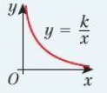
19.3 – Inverse Proportion
Page 593
Key Point 3
When y is inversely proportional to x y ∝ $\frac{1}{x}$ y = $\frac{k}{x}$
Example 2
y is inversely proportional to x. When y = 2, x = 3
Write a formula for y in terms of x.
Calculate the value of y when x = 8.
a y ∝ $\frac{1}{x}$ so y = $\frac{k}{x}$
2 = $\frac{k}{3}$ so k = 6
y = $\frac{6}{x}$
b y = $\frac{6}{8}$ = $\frac{3}{4}$
Write y is inversely proportional to x, using the symbol ∝. Then write the equation using k.
Substitute y = 2 and x = 3. Solve to find k.
Substitute k back into the equation.
Substitute x = 8 into your formula.

Slide 32
19.3 – Inverse Proportion
Page 593
y is inversely proportional to x. When y = 5, x = 2
Write a formula for y in terms of x.
Calculate the value of y when x = 20
Calculate the value of x when y = 4
STEM / Reasoning The pressure, P (in N/m²), of a gas is inversely proportional to the volume, V (in m³). P = 1500 N/m² when V= 2m³
Write a formula for P in terms of V.
Work out the pressure when the volume of the gas is 1.5 m³.
Work out the volume of gas when the pressure is 1200 N/m².
What happens to the volume of the gas when the pressure doubles?

Slide 33
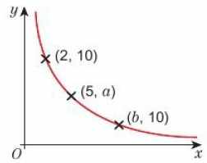
19.3 – Inverse Proportion
Page 593
Problem-solving / STEM The time taken, t (in seconds), to boil water in a kettle is inversely proportional to the power, p (in watts), of the kettle. A full kettle of power 1500W boils the water in 400 seconds,
Write a formula for t in terms of p.
A similar kettle has a power of 2500 W. Can this kettle boil the same amount of water in less than 3 minutes?
Problem-solving The graph shows two variables that are inversely proportional to each other. Find the values for a and b.

Slide 34
19.3 – Inverse Proportion
Page 594
Reasoning y is inversely proportional to x.
Draw a graph of y and x. What type of graph is this?
y = $\frac{k}{x}$ where k is the constant of proportionality. Find k.
Work out x x y for each pair of values in the table. What do you notice?
Discussion How can you tell from a table of values if two variables are inversely proportional.
x | 0.25 | 0.5 | 1 | 2 | 4 | 8 | 16 | 32
y | 32 | 16 | 8 | 4 | 2 | 1 | 0.5 | 0.25

Slide 35
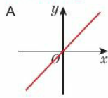
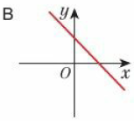
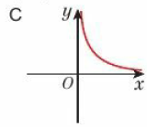
19.3 – Inverse Proportion
Page 594
Reasoning Which graph shows variables in inverse proportion?
11 – Exam-Style Questions
h is inversely proportional to the square of r. When r = 5, h = 3.4
Find the value of h when r = 8 (3)
June 2013, Q22, 1MAO/2H
Exam hint - Read the question thoroughly. Note that you need to use inverse proportion.

Slide 36
19.3 – Inverse Proportion
Page 594
STEM / Reasoning The time, t (in seconds), it takes an object to travel a fixed distance is inversely proportional to the speed, s (in m/s), at which the object is travelling. When travelling at 20 m/s it takes an object 40 seconds to travel from A to B.
Write a formula for s in terms of t.
Copy and complete the table of values for s and t.
Sketch a graph to show how s varies with t.
Discussion What happens to the time taken as the speed approaches 0 m/s?
Speed, s, (m/s) | 4 |  | 20 | 40 |  | 160
Time, t, (secs) |  | 80 | 40 |  | 10

Slide 37
19.3 – Inverse Proportion
Page 594
Reasoning A farmer employs fruit pickers to harvest his apple crop. The fruit pickers work in different-sized teams. The farmer records the times it takes different teams to harvest the apples from 10 trees.
Draw a scatter graph of t against n.
Draw a curve of best fit.
Write a formula for estimating t when given n.
Use your formula to estimate the time it would take a team of 15 people to harvest the apples from 10 trees.
Number of people in team, n | 43 | 2 | 5 | 8 | 9 | 10 | 6 | 4 | 7
Time taken, t (minutes) | 95 | 155 | 60 | 40 | 30 | 25 | 40 | 85 | 40
Q10d hint – t = $\frac{k}{[ ]}$ Use a coordinate on the line of best fit to find the value of k.

Slide 38
19.3 – Inverse Proportion
Page 595
y is inversely proportional to the cube of x. When y = 2, x = 3
Write a formula for y in terms of x.
Calculate y when x = 5
Calculate x when y = 6.75
y is inversely proportional to the square root of x. When y = 2, x = 9
Write a formula for y in terms of x.
Calculate y when x = 4
Calculate x when y = 6

Slide 39
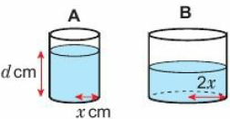
19.3 – Inverse Proportion
Page 595
Reasoning When 20 litres of water are poured into any cylinder, the depth, D (in cm), of the water is inversely proportional to the square of the radius, r (in cm), of the cylinder. When r = 15cm, D = 28.4cm
Write a formula for D in terms of r.
Find the depth of the water when the radius of the cylinder is 25cm.
Find the radius of the cylinder when the depth is 64 cm.
Cylinder A has radius x cm and is filled with water to a depth of d cm. This water is poured into cylinder B with radius 2x cm. What is the depth of water in cylinder B?

Slide 40
19.3 – Inverse Proportion
Page 595
Reasoning The speed, s (in revolutions per minute), at which each cog in a machine turns is inversely proportional to the square of the radius, r (in cm). When r = 4cm, s = 212.5 revolutions per minute,
Write a formula for s in terms of r.
Workout the value of s when r = 4.2. Round your answer to 2 decimal places.

Slide 41
19.4 – Exponential Functions
Page 595
Objectives |  |  | Why Learn This?
Recognise graphs of exponential functions. Sketch graphs of exponential functions. |  |  | Exponential graphs are used by scientists to describe population growth and radioactive decay.
Fluency
Work out the value of 2³, 6⁻¹, 3⁻², 3, 5°
ActiveLearn - Homework, practice and support: Higher 19.4

Slide 42
19.4 – Exponential Functions
Page 595
Calculate
2⁴ b. 9° c. 5⁻¹ d. 4⁻²
A man places a grain of rice on the first square of a chess board. He then places two grains on the second square, four on the third square, eight on the fourth square, and so on, doubling the number of grains each time. How many grains of rice does he place on the
10th square b. 15th square
20th square?
Discussion What happens to the amount of rice as he moves further around the chessboard?
Warm Up

Slide 43
19.4 – Exponential Functions
Page 596
Key Point 4
Expressions of the form a^{x}, where a is a positive number, are called exponential functions.
Key Point 5
The graph of an exponential function has one of these shapes.
Hint - The graph of y = a^{x} when a = 1 is just the graph of y = 1.
y = a^{x} where a > 1 or y = b^{-x} where 0 < b < 1 exponential growth
y = a^{-x} where a > 1 or y = b^{x} where 0 < b < 1 exponential decay

Slide 44
19.4 – Exponential Functions
Page 595
Find the value of* for each of these equations,
2^{x} = 8
3^{x} = 81
10^{x} = 10000
a. Copy and complete the table of values for 0 = 2^{x}. Give the values correct to 2 decimal places.
Draw the graph of y = 2^{x} for -4 ≤ x ≤ 4.
Use the graph to find an estimate for
the value of 0 when x = 3.5
the value of x when y = 10.
Discussion What happens to the value of y as the value of x decreases?
Q3a hint – 2◻ = 8
x | -4 | -3 | -2 | -1 | 0 | 1 | 2 | 3 | 4
y

Slide 45
19.4 – Exponential Functions
Page 596
Reasoning
Draw the graph of each function. Use a grid with x-axis -2 to 2 and y-axis 0 to 30.
y = 3^{x} ii. y = 5^{x}
Predict where the graph of y = 4^{x} would be. Sketch it on the same axes.
At which point do all the graphs intersect the y-axis?
Discussion Why do exponential graphs always cross the y-axis at the same point?
Q3 hint - Create a table of values similar to Q4a.

Slide 46
19.4 – Exponential Functions
Page 596
Reasoning
Copy and complete the table of values for y = 2^{x}. Give the values correct to 2 decimal places.
Draw the graph of y = 2^{x} for -4 ≤ x ≤ 4
Use the graph to find an estimate for
the value of y when x = 3.5
the value of x when y = 10
x | -4 | -3 | -2 | -1 | 0 | 1 | 2 | 3 | 4
y

Slide 47
19.4 – Exponential Functions
Page 596
STEM / Reasoning The table gives information about the count rate of seaborgium-266. The count rate is the number of radioactive emissions per second.
Draw a graph of the data. Plot time on the horizontal axis and count rate on the vertical axis.
Is this an example of exponential growth or exponential decay?
The half-life of a radioactive material is the time it takes for the count rate to halve. What is the half-life of seaborgium-266?
Time (secs) | 0 | 30 | 60 | 90 | 120 | 150 | 180
Count Rate | 800 | 400 | 200 | 100 | 50 | 25 | 12.5

Slide 48
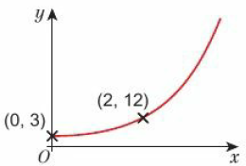
19.4 – Exponential Functions
Page 597
Example 3
The sketch shows part of the graph y = ab^{x}. The points with coordinates (0,3) and (2,12) lie on the graph. Work out the values of a and b.
y = ab^{x}
3 = a x b⁰
3 = a x 1
A = 3
y = 3b^{x}
12 = 3b²
4 = b
b = 2
For the point (0, 3) substitute x = 0 and y = 3 into y = ab^{x}
b⁰ = 1
a = 3, so the equation is y = 3b^{x}
For the point (2, 12), substitute x = 2 and y = 12 into y = 3b^{x}

Slide 49
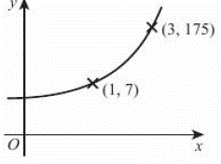
19.4 – Exponential Functions
Page 597
8 – Exam-Style Questions
The sketch shows a curve with equation y = ka^{x}, where k and a are constants and a > 0. The curve passes through the points (1,7) and (3, 175). Calculate the value of k and the value of a. (3 marks)
June 2008, Q18, 5544H/15H
Exam hint - Start by using the point (1, 7) to express k in terms of a.

Slide 50
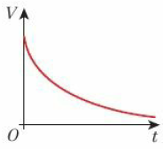
19.4 – Exponential Functions
Page 596
Finance / Reasoning The value, V (in £), of a car depreciates exponentially over time.
The value of the car on 1 January 2015 was £20000. The value of the car on 1 January 2017 was £16200. The sketch graph shows how the value of the car changes over time. The equation of the graph is V = ab^{t} where t is the number of years after 1 January 2015, and a and b are positive constants.
Use the information to find the value of a and b.
Use your values of a and b in the formula V = ab^{t} to estimate the value of the car on 1 January 2018.
By what percentage does the car depreciate each year?

Slide 51
19.4 – Exponential Functions
Page 596
Reasoning / Modelling The population of a country is currently 4 million, and is growing at a rate of 5% a year. The expected population, p (in millions), in t years' time, is given by the formula p = 4 x 1.05^{t}
Use a table of values to draw the graph of p against t for the next 6 years,
Use your graph to estimate
the size of the population after 2.5 years
the time taken for the population to reach 5 million.
Reflect How do you know that the growth in population is exponential?

Slide 52
19.4 – Exponential Functions
Page 598
Reasoning / Finance £10000 is invested in a savings account paying 4% compound interest a year.
Write a formula for the value of the savings account (V) and the number of years (t)
Draw a graph of V against t for the first 10 years.
Use the graph to estimate when the investment will reach the value of £11,000.

Slide 53
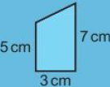
19.5 – Non-Linear Graphs
Page 595
Objectives |  |  | Why Learn This?
Calculate the gradient of a tangent at a point. Estimate the area under a non-linear graph. |  |  | Formula 1 engineers use curved speed-time graphs to track the performance of their cars.
Fluency
Calculate the area of
ActiveLearn - Homework, practice and support: Higher 19.5

Slide 54
19.5 – Non-Linear Graphs
Page 598
Warm Up
The diagrams show four flasks filling up with water, h is the height of water after time t. These graphs each show a relationship between h and t. Match each flask to a graph.

Slide 55
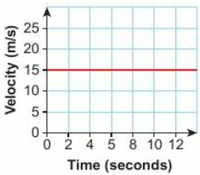
19.5 – Non-Linear Graphs
Page 598
The velocity-time graph shows the motion of a particle. Given that the particle travelled in a straight line, calculate the distance travelled between t = 0 and t = 12.
Warm Up

Slide 56
19.5 – Non-Linear Graphs
Page 598
Points A and B are connected by a straight line. Write the gradient of the line AB for
A(0, 0) and B(2, 6)
A(3, 5) and B(7, 11)
A(-2, 4) and B(2, 0)
Warm Up
Key Point 1
The tangent to a curved graph is a straight line that touches the graph at a point.
The gradient at a point on a curve is the gradient of the tangent at that point.

Slide 57
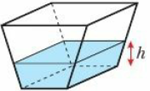
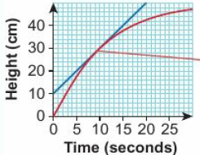
19.5 – Non-Linear Graphs
Page 599
Example 4
Water is poured into the container at a constant rate.
The graph shows the height, h (in cm), of the water after time, t (in seconds).
Estimate the rate at which h is increasing after 10 seconds.
Gradient = $\frac{change in h}{change in t}$ = $\frac{50 −10}{20 −0}$ = $\frac{40}{20}$ = 2
At t = 10 the height of the water is increasing at 2cm per sec.
Draw a tangent to the curve at t = 10
Calculate the gradient of the tangent.

Slide 58
19.5 – Non-Linear Graphs
Page 599
Communication Water is poured into a flask at a constant rate. h is the height of water after time, t.
Describe how the rate at which the height increases changes over time.
Which graph best describes the relationship between h and t?

Slide 59
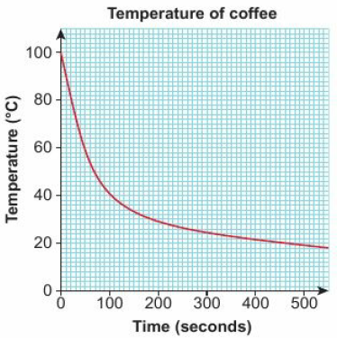
19.5 – Non-Linear Graphs
Page 599
Reasoning / Communication The graph shows the relationship between the temperature, T, of a cup of coffee and time, t.
What is the temperature, T, of the coffee after 50 seconds?
Describe the rate at which the coffee cools down.
Calculate the drop in temperature between 100 and 200 seconds.
Calculate the average rate of temperature reduction between 100 and 200 seconds.
Becky says, The coffee cools twice as quickly between 100 and 200 seconds as between 0 and 400 seconds.' Is Becky correct? Explain your answer.
Compare the average rate of temperature reduction over the first 300 seconds with the rate of temperature reduction at exactly 300 seconds.
Q5 hint - Find the temperature at t = 100 and t = 200.

Slide 60
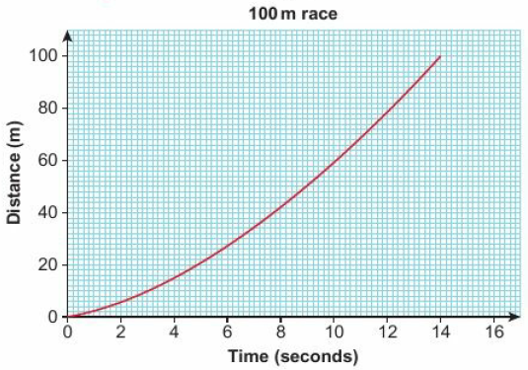
19.5 – Non-Linear Graphs
Page 600
Key Point 7
On a distance-time graph, the gradient of the tangent at any point gives the speed.
Reasoning The distance-time graph shows information about a runner in a 100 metre race.
Estimate the speed of the runner 12 seconds into the race,
After how many seconds is the runner running at full speed?
If the runner could maintain this speed, how long would it take to run a 200 m race?

Slide 61
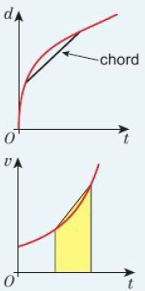
19.5 – Non-Linear Graphs
Page 600
Key Point 8
The straight line that connects two points on a curve is called a chord. The gradient of the chord gives the average rate of change and can be used to find the average speed on a distance-time graph.
The area under a velocity-time graph shows the displacement, or distance from the starting point. To estimate the area under a part of a curved graph, draw a chord between the two points you are interested in, and straight lines down to the horizontal axis to create a trapezium. The area of the trapezium is an estimate for the area under this part of the graph.

Slide 62
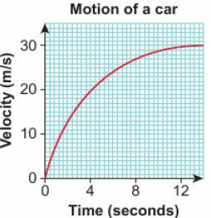
19.5 – Non-Linear Graphs
Page 600
Reasoning / Communication A car drives away from a set of traffic lights. The velocity-time graph gives some information about the motion of the car.
Copy the graph. Draw a chord from t = 0 to t = 10.
Calculate the average acceleration of the car over the first 10 seconds.
Estimate the acceleration at time t = 4 seconds,
Describe how the acceleration changes over the 12 seconds,
Estimate the displacement of the car from t = 4 to t = 8.
Discussion Is the displacement always the same as the distance travelled?
Q7 hint - Find the gradient of the chord

Slide 63
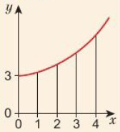
19.5 – Non-Linear Graphs
Page 601
a Draw the graph of y = x²+ 3 for 0 ≤ x ≤ 4
Draw in a chord from x = 0 to x = 1 and use it to make a trapezium under the graph.
Repeat with chords from x = 1 to x = 2, x = 2 to x = 3 and x = 3 to x = 4.
Calculate the areas of your trapezia to estimate the area under the graph of y = x² + 3 from x = 0 to x = 4
Q8 hint –

Slide 64
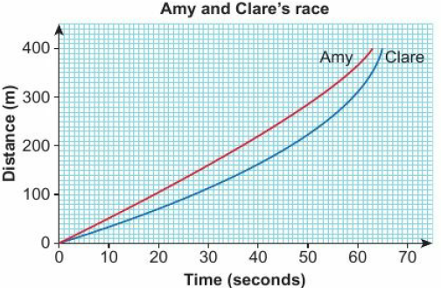
19.5 – Non-Linear Graphs
Page 601
Reasoning / Communication The distance-time graph shows information about a 400 m race between Amy and Clare.
Describe the race between Amy and Clare,
Compare Clare's speeds for the first and second halves of the race,
Estimate the difference in their speeds 50 seconds into the race.

Slide 65
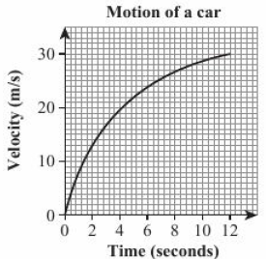
19.5 – Non-Linear Graphs
Page 601
10 – Exam-Style Questions
The velocity-time graph describes the motion of a car. Velocity, v, is measured in metres per second (m/s) and time, t, is measured in seconds. The car travels in a straight line.
Estimate the acceleration at t = 4. (2)
Estimate the distance travelled between t = 6 and t = 8. (3)
The instantaneous acceleration at time T is equal to the average acceleration for the first 8 seconds. Find an estimate for the value of T. (3)
Q10a hint - For motion, draw a tangent to the curve.
Q10c communication hint - Instantaneous acceleration is the acceleration at a given moment (or instant) in time.
Q10c hint - Calculate the average acceleration for the first 8 seconds..

Slide 66
19.6 – Translating Graphs of Functions
Page 602
Objectives |  |  | Why Learn This?
Understand the relationship between translating a graph and the change in its function notation. |  |  | Architects, designers and artists all use different types of transformations to create inspirational designs.
Fluency
The point (1,2) is translated by (${3 \atop 0}$) Find the new coordinate. The point (-3, 4) is translated by (${0 \atop −2}$) Find the new coordinate.
ActiveLearn - Homework, practice and support: Higher 19.6

Slide 67
19.6 – Translating Graphs of Functions
Page 602
f(x) = 3x + 1, g(x) = 2x² Find the values of
f(2) b. f(-3)
g(1) d. f(0)
g(x) = 5x + 2
Find the value of
g(3) + 2
g(3 + 2)
Write out in full
y = g(x) + 2
y = g(x + 2)
Warm Up

Slide 68
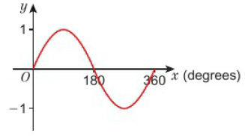
19.6 – Translating Graphs of Functions
Page 602
Here is the graph of y = sin x Match the equations to these graphs,
y = sinx + 0.5
y = sin(x + 30)
Warm Up

Slide 69
19.6 – Translating Graphs of Functions
Page 602
Communication Draw a coordinate grid with -5 to +5 on the x-axis and with-10 to +30 on the y-axis.
On the same set of axes d raw the graphs of
y = f(x) = x²
y = f(x) - 5 = x² – 5
y = f(x + 1) = (x +1)²
The minimum point of y = f(x) is (0, 0). Write the coordinates of the minimum point of
y - f(x) - 5 ii. y = f(x + 1)
Describe the transformation that maps the graph of y = f(x) onto the graph of
y = f(x) - 5 ii. y - f(x + 1)
Q4a hint – Create a table of values for each graph.

Slide 70
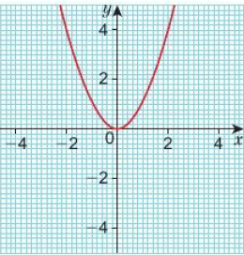
19.6 – Translating Graphs of Functions
Page 603
Key Point 9
The graph of y = f(x) is transformed into the graph of y = f(x) + a by (${0 \atop a}$)
The graph of y = f(x) is transformed into the graph of y = f(x + a) by (${−a \atop 0}$)
Here is the graph of y = f(x) = x² Copy the axes and sketch the graphs of
y = f(x) +1 b. y = f(x) - 2
y = f(x + 1)
y = f(x- 4)
Q5 hint – Label the coordinates of the turning point and the y-intercept on each of your sketch graphs.

Slide 71
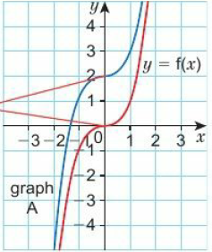
19.6 – Translating Graphs of Functions
Page 603
Example 5
Graph A is a translation of the graph of y = f(x).
Write the equation of graph A.
The graph of y = f(x) has been translated by (${2 \atop 1}$)
The equation of graph A is y = f(x) + 2
Find the corresponding points on the graph, for example where the graph is horizontal
Describe the translation to the corresponding point.
Write your final answer in functional notation.

Slide 72
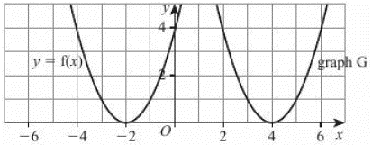
19.6 – Translating Graphs of Functions
Page 603
Write the vector that translates y = f(x) onto
y = f(x) + 2 b. y = f(x) - 3
y = f(x + 1) d. y = f(x- 4)
y = f(x + 5) - 2
7 – Exam-Style Questions
The graph of y – f(x) is shown on the grid
The graph G is a translation of the graph of y = f(x). Write down the equation of graph G. (1 mark)
March 2013, Q25b, 1MA0/1H
Exam hint - First see if the translation is to the right, left, up or down and by how many squares.

Slide 73
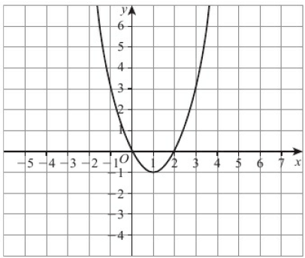
19.6 – Translating Graphs of Functions
Page 604
8 – Exam-Style Questions
The graph of y = f(x) is shown on the grid. Copy the diagram and sketch the graph of y = f(x - 3). (2 marks)
June 2012, Q26a, 1MA0/1H
Q8 strategy hint - Make sure you translate the points that have integer coordinates such as (-1,3) and (2,0) exactly three squares in the correct direction.

Slide 74
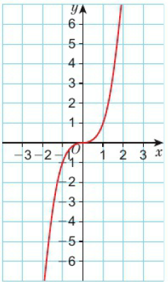
19.6 – Translating Graphs of Functions
Page 604
Here is a sketch of y = f(x) = x³
Draw sketches of the graphs
y = f(x) + 3
y = f(x - 3)
Write the coordinates of the point which (0,0) is mapped to for both graphs.
Reasoning f(x) = 3x + 2
Draw the graph of y = f(x)
Draw the graph of y = f(x + 1)
Write the algebraic equation of y = f(x +1)

Slide 75
19.6 – Translating Graphs of Functions
Page 604
Problem-solving f(x)= $\frac{1}{x}$
Sketch the graph of y = f(x + 2) - 3
Write the equation of each asymptote.
Q11 communication hint - An asymptote is a line that a curve approaches but never reaches.

Slide 76
19.7 – Reflecting and Stretching Graphs of Functions
Page 605
Objectives |  |  | Why Learn This?
Understand the effect stretching a curve parallel to one of the axes has on its function form. Understand the effect reflecting a curve in one of the axes has on its function form. |  |  | Function transformations are used in computer animation software.
Fluency
Paul draws a curve by connecting coordinates. What happens to the curve if he doubles all the y-values, but keeps the x-values the same
ActiveLearn - Homework, practice and support: Higher 19.7

Slide 77
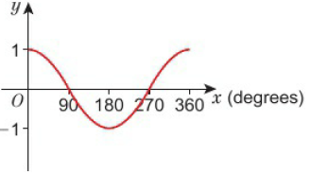
19.7 – Reflecting and Stretching Graphs of Functions
Page 605
f(x) = 6x - 4 Write out in full
f(-2) b. -f(x)
g(x) = 2x + 5 Find
-g(-3) b. 2g(10)
Here is the graph of y = cos x Sketch the graph of
y = -cos x b. y = 2cosx
Warm Up

Slide 78
19.7 – Reflecting and Stretching Graphs of Functions
Page 605
f(x) = 4x - 2
Copy and complete the table.
On the same set of axes, draw the graphs of
y = f(x) ii. y = -f(x)
y = f(-x)
Describe the transformation that maps f(x) onto -f(x).
Describe the transformation that maps f(x) onto f(-x).
x | -2 | -1 | 0 | 1 | 2
f(x)
-f(x)
f(-x)

Slide 79
19.7 – Reflecting and Stretching Graphs of Functions
Page 605
Key Point 10
The transformation that maps the graph y = f(x) onto the graph y = f(-x) is a reflection in the y-axis.
The transformation that maps the graph y = f(x) onto the graph y = -f(x) is a reflection in the x-axis.

Slide 80
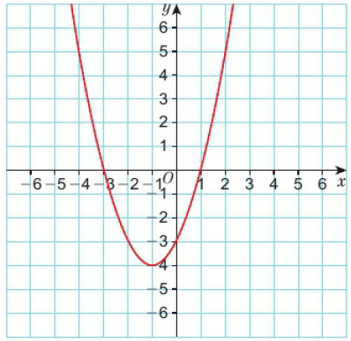
19.7 – Reflecting and Stretching Graphs of Functions
Page 606
Reasoning The diagram shows the graph of y = f(x)
Copy the sketch. On the same axes sketch the graphs of
y = -f(x) ii. y = f(-x)
Finley says, 'The graphs of y = f(x) and y = -f(x) always intersect the y-axis in the same place. The graphs of y = f(x) and y = f(-x) always intersect the x-axis in the same place.' Is Finley right? Explain your answer.

Slide 81
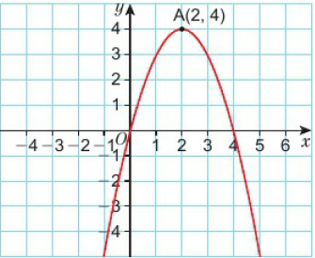
19.7 – Reflecting and Stretching Graphs of Functions
Page 606
Reasoning The diagram shows the graph of y = f(x) The turning point of the curve is A(2, 4). Write the coordinates of the turning points of the curves with these equations,
y = -f(x) b. y = f(-x) c. y = -f(-x)

Slide 82
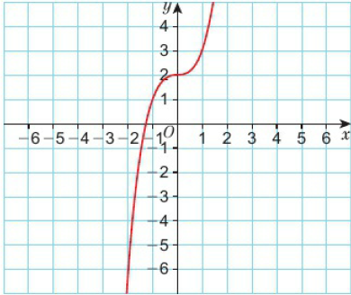
19.7 – Reflecting and Stretching Graphs of Functions
Page 606
Reasoning Here is the graph of y = f(x) – x² + 2
Copy the sketch and on the same axes sketch the graphs of
-f(x) ii. f(-x) iii. -f(-x)
Describe the transformation that maps f(x) onto -f(-x).

Slide 83
19.7 – Reflecting and Stretching Graphs of Functions
Page 607
f(x) = x² – 4
Copy and complete the table.
On the same set of axes draw the graphs of
y = f(x) ii. y = 2f(x)
y = f(2x)
x | -2 | -1 | 0 | 1 | 2
f(x)
2f(x)
f(2x)
Key Point 11
For any function, f, the transformation which maps the graph of y = f(x) onto the graph of y = af(x) is a stretch of scale factor a parallel to the y-axis.
For any function, f, the transformation which maps the graph of y = f(x) onto the graph of y = f(ax) is a stretch of scale factor $\frac{1}{a}$ parallel to the x-axis.

Slide 84
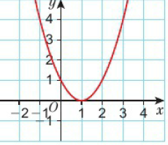
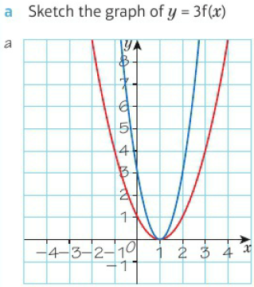
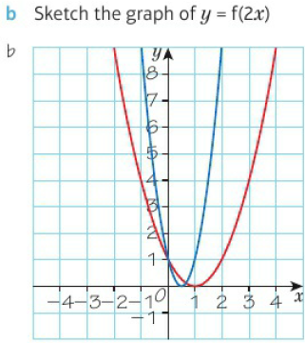
19.7 – Reflecting and Stretching Graphs of Functions
Page 607
Example 6
The diagram shows the graph of y = f(x), where f(x) = x² - 2x + 1
The transformation that maps y = f(x) onto y = f(2x) is a stretch of scale factor ½ parallel to the x-axis.
The y-coordinate on each graph will remain the same, but each x-coordinate will be multiplied by ½.
(1,0) → (0.5,0) (0,1) → (0,1) (2,1) → (1,1)
The transformation that maps y = f(x) onto y = 3f(x) is a stretch of scale factor 3 parallel to the y-axis.
The x-coordinate of each point on the graph will remain the same, but each x-coordinate will be multiplied by 3. y-coordinate will be multiplied by 3.
(1,0) → (1, 0) (0, 1) → (0, 3) (2,1) → (2, 3)

Slide 85
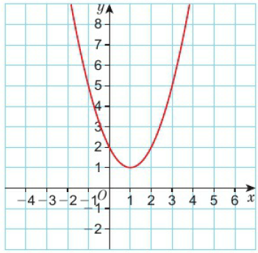
19.7 – Reflecting and Stretching Graphs of Functions
Page 608
Here is the graph of y = f(x) Draw the graphs of
y = 2f(x) b. y = 3f(x)
y = ½f(x)

Slide 86
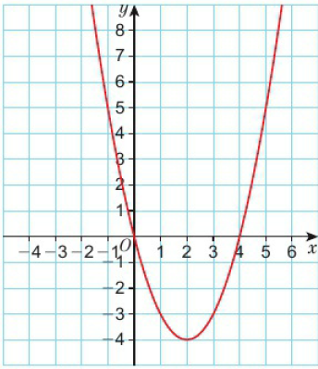
19.7 – Reflecting and Stretching Graphs of Functions
Page 608
Here is the graph of y = f(x) Draw the graphs of
y = f(2x) b. y = f($\frac{1}{3}$x)

Slide 87
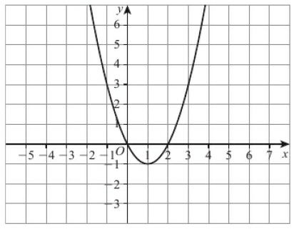
19.7 – Reflecting and Stretching Graphs of Functions
Page 608
11 – Exam-Style Questions
The graph of y = f(x) is shown on the grid. Copy the diagram and sketch the graph of y = 2f(x). (2 marks)
June 2012, Q26b, 1MA0I1H
Exam hint - Calculate some y-values for y = 2f(x) to make sure your graph passes through the correct points.

Slide 88
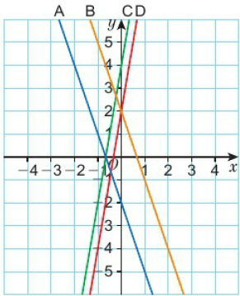
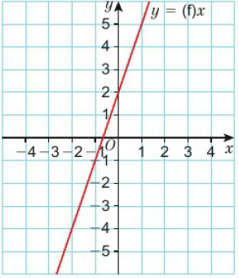
19.7 – Reflecting and Stretching Graphs of Functions
Page 609
Reasoning The diagram shows the graph of y = f(x) = 3x+ 2
The graph has been transformed in different ways. Match the function notation to the graphs,
f(2x) b. 2f(x) c. f(-x) d. -f(x)

Slide 89
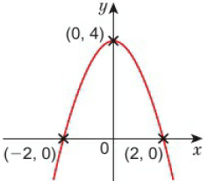
19.7 – Reflecting and Stretching Graphs of Functions
Page 609
Reasoning Here is a sketch of y = f(x) = -x² + 4 The graph has a maximum value at (0, A). It intersects the x-axis at (-2,0) and (2,0).
Sketch the graph of y = (2x)
Write the maximum value of f(2x).
Write the coordinates of the points where y = f(2x) intersects the x-axis.
Why does f(2x) have a maximum value?

Slide 90
19 – Problem-Solving: Modelling Outbreaks
Page 610
Objectives | Plot and interpret exponential graphs. Use and evaluate mathematical models.
Mathematics can be used to model disease outbreaks. This helps organisations to plan ahead and respond to emergencies.
One simple model for N, the number of infected people, is N = A x B^{t}, where A is the initial number of infected people, t is the time in days since the start of the outbreak, and B is a measure of how contagious the disease is.
One outbreak is modelled using the equation N = 7 x 2^{t} Calculate the number of people who are infected when t = 0, t = 1, t = 2, t = 3 and t = 4. When will the number of infected people exceed 100?
Q1 hint - You could draw and complete a table of values, and then plot a graph of N against t.

Slide 91
19.7 – Reflecting and Stretching Graphs of Functions
Page 609
A different outbreak of a long-lasting disease has begun in a nearby city. The local authorities have recorded the reported total number of infected people in the first five days in the table on the next slide,
Fit a model of the form N =A x B^{t} to this data, by finding approximate values of A (to the nearest integer) and B (to 1 decimal place).
The local authorities are worried about two things:
City doctors can only treat 500 newly infected people each day.
The hospitals currently only have enough supplies to treat 3000 infected people in total.
Use your model from part a to decide whether it is more urgent to send extra supplies or extra doctors. Justify your decision.
Q2a hint - To estimate B, find the ratios between the numbers of infected people on successive days

Slide 92
19.7 – Reflecting and Stretching Graphs of Functions
Page 609
Total number of infected people
Day | 0 | 1 | 2 | 3 | 4
Total number of infected people | Not known | 8 | 23 | 66 | 184
Fact
Instead of B, professional mathematicians use a value called R₀, the basic reproduction ratio of a disease. This is the mean number of people that a diseased person will infect while they are ill.
This table gives approximate R₀ values of some well-known diseases.
Disease | R₀
Measles | 12-18
Mumps | 4-7
Seasonal Flu | 1.2-1.4

Slide 93
19 – Check Up
Page 611
19. Check up | Log how you did on your Student Progression Chart
Proportion
In a circuit with a fixed resistance, the current, I, is directly proportional to the voltage, V. When the current is 10 amps, the voltage is 4 volts.
Write a formula for I in terms of V.
Calculate the current when the voltage is 10 volts.
When the voltage is constant and the resistance is allowed to vary, the current is inversely proportional to the resistance, R. When the resistance is 20 ohms, the current is 2 amps,
Write a formula for I in terms of R.
Calculate the current when the resistance is 4 ohms.

Slide 94
19 – Check Up
Page 611
y is directly proportional to x². When y = 48, x = 2
Write a formula for y in terms of x.
Find y when x = 3.
Find x when y = 300.
c is inversely proportional to d³. When c = 5.5, d = 4
Write a formula for c in terms of d.
Find c when d = 5.

Slide 95
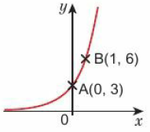
19 – Check Up
Page 611
Exponential and other non-linear graphs
On the same axes, sketch the graphs of
y = 2x b. y = 2^{-x} c. y = 3^{x}
Reasoning The diagram shows a sketch of the curve y = ab^{x} The curve passes through the points A(0,3) and B(l, 6).
Find the values of
a
b
Find the value of y when x = 4.

Slide 96
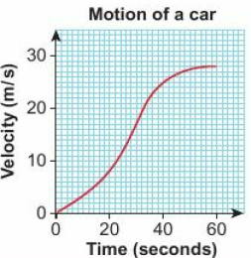
19 – Check Up
Page 611
Reasoning The velocity-time graph shows a car driving in a straight line away from a junction. The time after the junction, t. is measured in seconds, s. The velocity, v, is measured in metres per second, m/s.
Calculate the average acceleration of the car between t = 20 and t = 30.
Estimate the acceleration at t = 40.
Estimate the distance travelled between t = 40 and t = 60

Slide 97
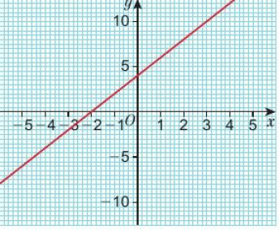
19 – Check Up
Page 612
Transformations of graphs functions
The function y = f(x) is shown in the diagram. Sketch the graph of
y = f(x) + 3 b. y = f(x - 2)
y = 2f(x) d. y = f(-x)

Slide 98
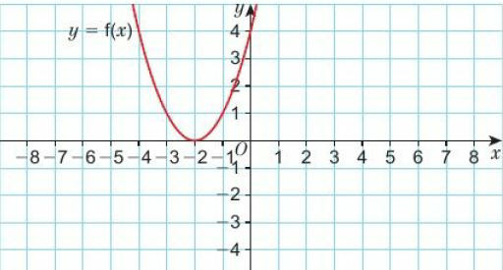
19 – Check Up
Page 612
y = f(x) - The graph of y = f(x) is shown on the grid. Copy the diagram and sketch the graph of y = -f(x)

Slide 99
19 – Check Up
Page 612
How sure are you of your answers? Were you mostly:
Just guessing ☹
Feeling doubtful 😐
Confident ☺ What next? Use your results to decide whether to strengthen or extend your learning.
Reflect

Slide 100
19 – Check Up
Page 612
* Challenge
Finley transforms the graph y = 4x + 3 using the transformations shown on the cards.
Does the order of the transformations change the final result?
There is more than one order that maps the graph onto itself.
Find the different orders of transformations that map the graph onto itself.
Explain why applying the transformations in different orders can lead to the same outcome.
Reflect in the x-axis
Translate (${0 \atop 4}$)
Reflect in the y-axis
Translate (${1 \atop 0}$)
Q10a hint - Draw a sketch and try different orders.
Q10c hint - Use a combination of algebraic and function notation.

Slide 101
19 – Strengthen
Page 612
19. Strengthen | Log how you did on your Student Progression Chart
Proportion
Real The cost, c, of diesel is directly proportional to the number of litres, l, purchased. Diesel costs £1.32 a litre,
Write a formula for the cost of diesel.
Use your formula to calculate the amount of diesel you can purchase for £12.

Slide 102
19 – Strengthen
Page 613
Reasoning
Write the lengths, l, and widths, w, of different rectangles with an area of 24cm².
Is l directly or inversely proportional to w?
Draw a set of axes with l on the horizontal axis and w on the vertical axis. Draw a graph of possible lengths and widths of a 24cm² rectangle.
Q2b hint - l - □w or l = $\frac{\text{□}}{w}$?

Slide 103
19 – Strengthen
Page 613
The graphs show how two pairs of variables relate to each other. Which graph shows
direct proportion
inverse proportion?

Slide 104
19 – Strengthen
Page 613
Write
the statement of proportionality
the formula for each of these,
A is directly proportional to B.
C is inversely proportional to D.
M is directly proportional to the square of N.
F is inversely proportional to the cube of G.
His inversely proportional to the square root of T.
R is directly proportional to the cube of S.
Q4 hint - Use ∝ to write a statement of proportionality, y ∝ x Use k (the constant of proportionality) to create a formula, y = kx

Slide 105
19 – Strengthen
Page 613
F is directly proportional to a. F= 20 when a = 2 F ∝ a so F= ka, where k is the constant of proportionality.
Find the value of k.
Write a formula for F in terms of a.
Work out the value of F when a = 4.
Work out the value of a when F = 60.
Q5a hint - Substitute F= 20 and a = 2 into F = ka
Q5b hint – Use F = ka and your value for k.
Q5c hint – Use your formula from part b.

Slide 106
19 – Strengthen
Page 613
a is inversely proportional to b. When a = 10, b = 2 a ∝ $\frac{1}{b}$ so a = $\frac{k}{b}$ where k is the constant of proportionality.
Find the value of k.
Write a formula for a in terms of b.
Calculate a when b = 5.
Calculate b when a = 5.
Q6a hint - Substitute a = 10 and b = 2 into the formula a = $\frac{k}{b}$

Slide 107
19 – Strengthen
Page 613
d is directly proportional to the square of t. d = 80 when t = 4 d ∝ t² so d = kt², where k is the constant of proportionality,
Find the value of k.
Write a formula for d in terms of t.
Calculate the value of d when f = 7.
Calculate the positive value of t when d = 45.
Q7 hint – The 'square of t' means t².

Slide 108
19 – Strengthen
Page 614
Exponential and other non-linear graphs
STEM The number of bacteria, n, in a Petri dish doubles every minute. At time t = 0 minutes there is 1 bacterium in the Petri dish,
Copy and complete the table of values.
Draw a set of axes, with n on the vertical axis from 0 to 70 and t on the horizontal axis from 0 to 6.
Sketch a graph of t and n on your axes.
t | 0 | 1 | 2 | 3 | 4 | 5 | 6
n | 1
Q1c hint – Roughly plot the values from part a.

Slide 109
19 – Strengthen
Page 614
Reasoning The diagram shows a sketch of the curve y = ab^{x}
The curve passes through the points A(0, 4) and B(1, 8).
Substitute the values of a: and y from point A into y = abx
Find the value of a.
Substitute the values of x and y from point B and your value of a into y = ab^{x}
Find the value of b.
Substitute your values of a and b into y = ab^{x}
Find the value of y when x = 3.
Q2b hint – b° = 1
Q2d hint – b¹ = b
Q2e hint – b³ = b x b x b

Slide 110
19 – Strengthen
Page 614
Reasoning The velocity-time graph shows a train pulling away from a station. The train travels in a straight line.
What is the velocity of the train at point:
A ii. B iii. C
Estimate the acceleration between points A and B.
Estimate the distance travelled between:
C and D ii. B and C.
Q3b hint – Acceleration - $\frac{change in velocity}{time taken}$
Q3c i. hint – Distance travelled = area under the graph.
Q3c ii. hint – Read off the values and draw a trapezium. Find the area of the trapezium underneath the line BC.

Slide 111
19 – Strengthen
Page 615
Transformations of graphs functions
f(x) = x²
Copy and complete the table of values for f(x).
Sketch the graph of y = f(x)
Copy and complete the table of values for 2f(x).
Copy and complete the sentence. For the same values of x, the values of 2f(x) are always ................. the values of f(x).
Sketch the graph of y = 2f(x)
Describe how y = f(x) is transformed into y = 2f(x)
Copy and complete the table of values for f(2x)
Sketch the graph of y = f(2x)
Describe how y = f(x) is transformed into y = f(2x)
x | -4 | -3 | -2 | -1 | 0 | 1 | 2 | 3 | 4
f(x)
x | -4 | -3 | -2 | -1 | 0 | 1 | 2 | 3 | 4
2f(x)
x | -4 | -3 | -2 | -1 | 0 | 1 | 2 | 3 | 4
f(2x)

Slide 112
19 – Strengthen
Page 615
f(x) = 2x - 4
Copy and complete the table of values for f(*).
Sketch the graph of y = f(*)
Copy and complete the table of values for f(x) + 3
Copy and complete the sentence. For the same values of x, the values of f(x) + 3 are always ................. than the values of f(x)
Sketch the graph of y = f(x) + 3
Describe how y = f(x) is transformed into y = f(x) + 3
Copy and complete the table of values for f(x + 2)
Sketch the graph of y = f(x +2)
Describe how y = f(x) is transformed into y = f(x + 2)
x | -3 | -2 | -1 | 0 | 1 | 2 | 3
f(x)
x | -3 | -2 | -1 | 0 | 1 | 2 | 3
f(x) + 3
x | -3 | -2 | -1 | 0 | 1 | 2 | 3
f(x + 2)

Slide 113
19 – Extend
Page 615
A ball falls vertically after being dropped. It falls a distance, d metres, in a time of t seconds. d is directly proportional to the square of t. The ball falls 20 metres in a time of 2 seconds,
Find a formula for d in terms of t.
Calculate the distance the ball falls in 3 seconds,
Calculate the time the ball takes to fall 605 m.
Sketch a graph of how d varies with t
Describe the motion of the ball.
Q1e hint - Describe any changes in its speed.

Slide 114
19 – Extend
Page 616
The diagram shows the graphs of y = 2^{x}, y = 6^{x}, y = 0.5^{x} and y = 3^{-x}. Match each graph to its equation.

Slide 115
19 – Extend
Page 616
Problem-solving Choose the graphs that best match the following descriptions,
The more petrol you buy, the higher the cost
The FTSE is rising more slowly than it has done for the last 6 months,
Someone tells a joke. At first no one laughs, but then a couple of his friends do and before long everyone in the class is in hysterics.
If you sell goods at a low price you don't make much profit, but if you charge too much people won't buy your product.
The smaller the radius of the balls, the more balls you can fit in a ball pool.

Slide 116
19 – Extend
Page 616
Reasoning The distance-time graph describes the distance, d, of a tennis ball from a fixed point as it is thrown vertically upwards,
Describe the motion of the ball at points A, B and C.
Compare the speed of the ball at A and C.
Compare the velocity of the ball at A and C.
Q4 hint - Velocity is a vector.
It is speed in a given direction.

Slide 117
19 – Extend
Page 616
5 – Exam-Style Questions
Jane invests £6000 for 3 years at 3% per annum compound interest,
a Calculate the value of her investment at the end of 3 years.
Lee invests a sum of money for 30 years at 4% per annum compound interest.
Which graph best shows how the value of Lee’s investment changes over the 30 years.
Hamish invested an amount of money in an account paying 5% per annum compound interest. After 1 year the value of his investment was £2775.
Work out the amount of money that Hamish invested. (5 marks)
Q5c strategy hint - This is not the same as finding 5% of £2775 and then subtracting the answer from £2775.

Slide 118
19 – Extend
Page 617
The graph shows a company's profits over a 6-month period,
Between which two months did the profit increase the fastest? Explain how the graph shows this.
Describe how the level of profit changed over this period.
Q4 hint - Use your answer to part a and describe the rate of change over the rest of the period.

Slide 119
19 – Extend
Page 617
STEM / Problem-solving As part of a science experiment, Michael places different-sized spheres into a measuring jug of water. He estimates the radius, r, of the spheres and measures the amount of water displaced, W. The table shows the results from his experiment.
Draw a scatter graph of Michaels results,
Which rule best describes the relationship between r and W?
Write a formula for estimating the relationship between r and W.
Estimate the amount of water displaced by a sphere with radius 16cm.
Radius, r (cm) | 2 | 8 | 6 | 10 | 5 | 1 | 3 | 4.5
Water displaced, W (liters) | 0.03 | 2.1 | 0.9 | 4.1 | 0.5 | 0.004 | 0.11 | 0.38
W ∝ r
W ∝ r²
W ∝ r³
W ∝ $\frac{1}{r}$
W ∝ $\frac{1}{r2}$
W ∝ $\frac{1}{r3}$

Slide 120
19 – Extend
Page 617
Problem-solving The diagram shows the graph of y = f(x) The graph intersects the x-axis at points A (-2, 0), B (0, 0) and C (2, 0). The graph intersects the y-axis at (0, 0).
Write the y-intercept of the graphs
y = 4f(x) ii. y = f(2x)
y = f(x) + 5
Write the y-intercepts of the graphs
y = f(x - 3) ii. y = f($\frac{x}{4}$)

Slide 121
19 – Extend
Page 618
Reasoning Here is the graph of y = f(x) = sinx
Sketch the graph with equation y = f($\frac{x}{2}$)
How many solutions does the equation f($\frac{x}{2}$) = 0.5 have in the range 0 < x < 360?

Slide 122
19 – Extend
Page 618
Reasoning f(x) = x² + 2x - 8
Write the coordinates of the points where y = f(x) intersects the x-axis.
Write the minimum value of y.
Sketch the graph of
y = f(x)
y = x² + 2x - 2
y = (x + 1)² + 2(x + 1) - 8
Q10a hint – Factorise x² + 2x -8
Q10b hint – Complete the square.

Slide 123
19 – Extend
Page 618
The expression x2 + 6x + 5 can be written in the form (x + a)² + b
Find the values of a and b.
Sketch the graph y = x²
On the same axes sketch the graph y = x² + 6x + 5
Q11 hint – When written in the form y = (x + a)² + 6 you can use the values of a and b to transform the curve y = x². You can do this in two steps.

Slide 124
19 – Extend
Page 618
Problem-solving The diagram shows the graph of y = a - b sin (cx). Use the graph to find the values of a, b and c.

Slide 125
19 – Extend
Page 618
Problem-solving The diagram shows the graphs of C₁ and C₂. C₁ is the graph of y = f(x) Write the equation of C₂ in function form.

Slide 126
19 – Extend
Page 619
Problem-solving Here is the graph of y = f(x) = $\frac{1}{x}$
Draw the graph of y = f(x + 2) - 3
Write the equations of the two asymptotes.

Slide 127
19 – Extend
Page 619
At the start of an experiment, the count rate of a sample of the radioactive substance nobelium-259 is 840 counts per second. The radioactive decay for nobelium-259 can be modelled by the iterative equation C_{t+1} = ½C, where C = count rate and t = time in hours. Calculate the count rate after 3 hours.
Q15 hint - C₀= 840. After 3 hours, t = 3.

Slide 128
19 – Extend
Page 619
Barry invests some money in a long-term savings account. The value of his investment after t years can be modelled by the iterative equation M_{t + 1} = 1.06 M_{t} After two years the value of his investment is £16854
Find the value of his investment after 3 years,
Find the value of his initial investment.
Q16 hint - Work backwards to find M₁ and M₀

Slide 129
19 – Knowledge Check
Page 619
19 – Knowledge Check
When a graph of two quantities is a straight line through the origin, one quantity is directly proportional to the other. The symbol ∝ means 'is directly proportional to'. If y is directly proportional to x, y ∝ x and y = kx, where k is a number, called the constant of proportionality. Where k is the constant of proportionality: if y is proportional to the square of x then y ∝ x² and y = kx² if y is proportional to the cube of x then y ∝ x³ and y = kx³ if y is proportional to the square root of x then y ∝ $\sqrt{x}$ and y = k$\sqrt{x}$...
Mastery Lesson 19.1
Mastery Lesson 19.1
Mastery Lesson 19.1

Slide 130
19 – Knowledge Check
Page 620
19 – Knowledge Check
When y is inversely proportional to x, y ∝ $\frac{1}{x}$ and y = $\frac{k}{x}$ To solve problems involving proportion: write the statement of proportionality write the formula substitute given values into the formula to find the solution. Expressions of the form a^{x} or a^{-x}, where a > 1, are called exponential functions.
Mastery Lesson 19.3
Mastery Lesson 19.3
Mastery Lesson 19.4

Slide 131
19 – Knowledge Check
Page 620
19 – Knowledge Check
The graph of an exponential function has one of these shapes Exponential graphs intersect the y-axis at (0,1) because a⁰ = 1 for all values of a. The tangent to a curved graph is a straight line that touches the graph at a point. The gradient at a point on a curve is the gradient of the tangent at that point.
Mastery Lesson 19.3
Mastery Lesson 19.4
Mastery Lesson 19.5

Slide 132
19 – Knowledge Check
Page 620
19 – Knowledge Check
The straight line that connects two points on a curve is called a chord. The gradient of the chord gives the average rate of change and can be used to find the average rate of change between two points. The area under a velocity-time graph shows the displacement, or distance from the starting point. To estimate the area under a part of a curved graph, draw a chord between the two points you are interested in, and straight lines down to the horizontal axis to create a trapezium. The area of the trapezium is an estimate for the area under this part of the graph
Mastery Lesson 19.5
Mastery Lesson 19.5

Slide 133
19 – Knowledge Check
Page 621
19 – Knowledge Check
The graph of y = f(x) is transformed into the graph of: y = f(x) + a by a translation of a units parallel to the y-axis or a translation by (${0 \atop a}$) y = f(x + a) by a translation of -a units parallel to the x-axis or a translation by (${−a \atop 0}$) y = f(-x) by a reflection in the y-axis. y = -f(x) by a reflection in the x-axis. y = af(x) by a stretch of scale factor a parallel to the y-axis. y= f(ax) by a stretch of scale factor $\frac{4}{7}$ parallel to the x-axis
Mastery Lesson 19.6
Mastery Lesson 19.6
Mastery Lesson 19.7
Mastery Lesson 19.7
Mastery Lesson 19.7

Slide 134
19 – Knowledge Check
Page 621
19 – Knowledge Check
Write down a word that describes how you feel: a before a maths test during a maths test (when you know how to answer a question) during a maths test (when you don't immediately know how to answer a question) after a maths test discuss with a classmate what you could do to change ☹ feelings to ☺ feelings.
Reflect
Hint - You might choose one of these (or a different word): OK, worried, excited, happy, focussed, panicked, calm. Beside each word, draw a face to show if it is a good or a bad feeling: ☺☹

Slide 135
19 – Unit Test
Page 621
19. Unit Test | Log how you did on your Student Progression Chart
The time, T (in seconds), it takes a water heater to boil some water is directly proportional to the mass of water, m (in kg), in the water heater. When m = 250, T = 600
Find T when m = 400.
The time, T (in seconds), it takes a water heater to boil a constant mass of water is inversely proportional to the power, P (in watts), of the water heater.
When P = 1400, T = 360 (3 marks)
Find the value of T when P = 900. (3 marks)

Slide 136
19 – Unit Test
Page 621
Write the letters of the graphs that could have equations
y – 3x – 2 b. y = -2x²
y = $\frac{4}{x}$
y = 3^{x} (4 marks)

Slide 137
19 – Unit Test
Page 622
The distance, D travelled by a particle is directly proportional to the square of the time taken, t. When t = 40, D = 30
Find a formula for A in terms of t. (3 marks)
Calculate the value of D when t = 64. (1 mark)
Calculate the value of t when A = 12. Give your answer correct to 3 significant figures.
(1 mark)

Slide 138
19 – Unit Test
Page 622
y is inversely proportional to x². Given that y = 2.5 when x = 24
find an expression for y in terms of x (3 marks)
find the value of y when x = 20 (1 mark)
find a value of x when y = 1.6 (1 mark)

Slide 139
19 – Unit Test
Page 622
Reasoning The sketch shows the graph of y = f(x) The maximum turning point at A has coordinates (-3,9). The graph intersects the x-axis at B (-6, 0) and C (0, 0). Write the coordinates of A, B and C for the graph of
y = -f(x)
y = f(-x)
y = f(x - 2)
y = 2f(x)
y = f(3x)
(5 marks)

Slide 140
19 – Unit Test
Page 622
Reasoning The velocity-time graph shows the first 60 seconds of a space shuttle flight. Time, t, is measured in seconds. Velocity, v, is measured in metres per second.
Calculate the average rate of acceleration between t = 40 and t = 50. (3)
Estimate the rate of acceleration at t = 30. (2)
Given that the shuttle travelled in a straight line, estimate the distance travelled between t = 20 and t = 30. (2)

Slide 141
19 – Unit Test
Page 623
The diagram shows a sketch of y = f(x) Sketch the graphs of
y = f(x) -1 b. y = 3f(x) (2)

Slide 142
19 – Unit Test
Page 623
Reasoning The diagram shows a sketch of the curve y = ab^{x} The curve passes through the points A(1, 12) and B(3,108).
Find the value of
a ii. b (5 marks)
Find the value of y when x = 4
(1 mark)

Slide 143
19 – Unit Test
Page 623
Sample student answer
Describe the key points to look for on a graph to help transform and sketch a curve correctly,
Which key point has the student got incorrect?
What could they draw on the graph to help make sure they count correctly when transforming?
Exam-Style Questions
Student answer
(-1, -3)
This is a graph of the function f(x)
Sketch the curve of the function y = f(x + 2) (2 marks)
Write the coordinates of the new minimum point (1 mark)

